Slide 1
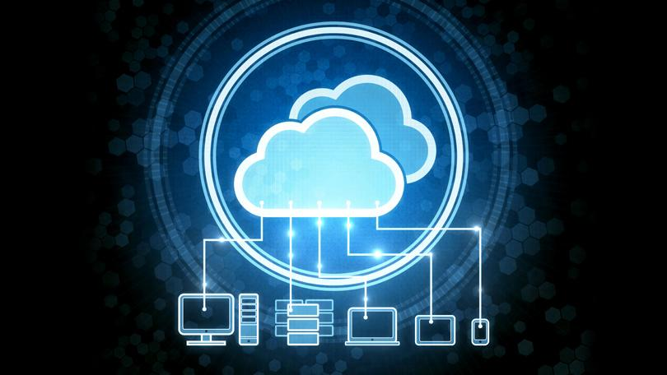
Software Product Line Technologies for Cloud Based Applications
TEAM #16
PARVA UDAYKUMAR BHAYANI
HELLY NILESHBHAI MODI
SUCHITA KIRANBHAI PATEL
SHALINI MUKESHKUMAR JAIN
AYUSHI KALPESH PATEL
Under the guidance of
Prof. Atef Bader

Slide 2

Software Product Line
A software product line is a portfolio of similar software-based systems and products produced from a shared set of software assets using a common means of production.
Software Product Line (SPL) engineering refers to the engineering and management techniques to create, evolve, and sustain a software product line.
It focuses more on customizing software to the needs of an individual organization.

Slide 3
Cloud Technologies
Cloud computing describes a new supplement, consumption and delivery model for IT Services based on Internet, and it typically involve the provision of dynamically scalable and often virtualized resources as a service over the internet.
Cloud computing provides us a means by which we can access the applications as utilities ,over the Internet. It allows us to create ,configure ad customize applications online.
Cloud is a model that enables virtualization of on-demand resources to provide remote services globally and efficiently.

Slide 4
Need of SPL in Cloud Technologies
Customization of cloud services in order to achieve.
Reusability.
Low Maintainability.
Reduce Development Cost.
High Reliability.
High Performance.
Gain Productivity.
Always on availability

Slide 5
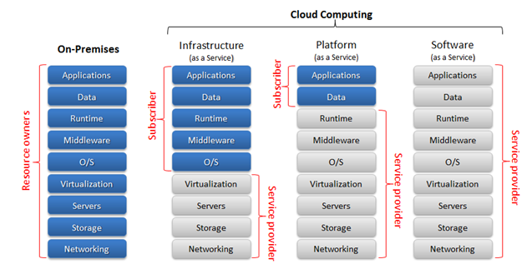
Cloud Service models- Iaas vs PaaS vs SaaS

Slide 6
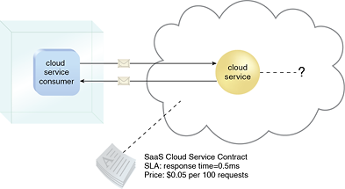
Software as a Service (SaaS)
SaaS systems are built on platforms that provide resource virtualization capabilities like abstraction from location and size of data storage.
(SaaS): In this model, a complete application is offered to the customer, as a service on demand. A single instance of the service runs on the cloud & multiple end users are serviced.
On the customers‟ side, there is no need for upfront investment in servers or software licenses, while for the provider, the costs are lowered, since only a single application needs to be hosted & maintained.
Benefits of SaaS are: 1) Low operational costs. 2) Cheaper from maintenance and customer-support perspective.
Drawbacks of SaaS are: 1) Higher complexity in application. 2) Functional and Behavioural variation is rather narrow. 3) Customer-specific functionality is not integrated (in a cloud setting) as it would impact the capabilities of all other customers.
Figure - The cloud service consumer is given access the cloud service contract, but not to any underlying IT resources or implementation details.

Slide 7
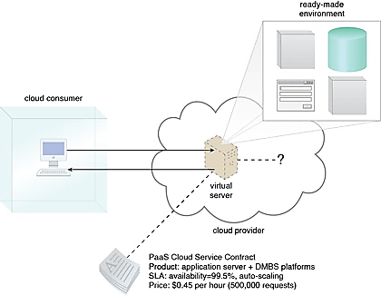
Platform as a Service (PaaS)
Platform as a Service means you develop applications using Web-based tools so they run on systems software and hardware provided by another company.
PaaS focuses on providing the platform that can create, host and deploy applications and thereby saving developers from complexity of building and managing the infrastructure level resources.
App Cloud (from salesforce.com) and the Google App Engine are examples of PaaS.
PaaS configures platform on basis of availability and nature of domain.
1)Domain Specific Platform(Single Platform among different applications)
2)Domain Independent Platform(Different Platform for each different applications)
Figure – A cloud consumer is accessing a ready-made PaaS environment. The question mark indicates that the cloud consumer is intentionally shielded from the implementation details of the platform.

Slide 8
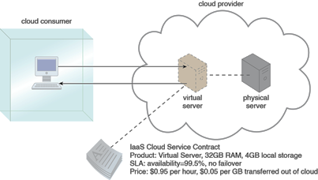
Infrastructure as a Service (IaaS)
Objective of IaaS is to provide computing resources such as processing power, network capacity or storage at low cost in unlimited amount. It is suitable for distributed applications.
Its capabilities are adaptive that change with changes in environment. For example, they may suffer from load fluctuations.
An important challenge in this respect regards avoiding impacting the performance of cloud applications by dynamically allocating further computing resources, while minimizing the applications' monetary costs by reducing the amount of acquired resources.
To attain this goal, cloud configurations should be able to deal with the dynamism of the applications resource demand at runtime by reallocating resources while minimizing the monetary costs of the extra resources acquired.
IaaS-based customization is probably only a good approach in very extreme cases like the following: 1) Very large installations 2) Very significant differences among the systems.
A cloud consumer is using a virtual server within an IaaS environment. Cloud consumers are provided with a range of contractual guarantees by the cloud provider, pertaining to characteristics such as capacity, performance, and availability.

Slide 9

Summary
 | Advantages | Disadvantages
SaaS | Universally Accessible From Any Platform No Need To Commute, You Can Work From Anyplace Excellent For Collaborative Working Vendor Provides Modest Software Tools Allows For Multi-Tenancy | Portability And Browser Issuses Internet Performance May Dictate Overall Performance Compliance Restrictions
PaaS | Cost effective rapid development (It’s Scalable) Faster Market for Developers Easy Deployment of web application Private or public development is possible | Developers are limited to the provider’s language and tools Migration issues - such as the risk of vendors lock-in
Iaas | The Cloud Provides the infrastructure Enhanced scalability - dynamic workloads are supported IaaS is Flexible | Security issues Network and Service Delays

Slide 10
Conclusion
Problem:
How to address variability in cloud computing ?
Concern:
To analyze capability of cloud computing systematically and to merge with software product line capabilities.
Approach:
To customize cloud services which helps in achieving:
Reusability.
Low Operational Cost.
Maximum resource and service sharing.
Complexity Reduction.
High Performance.

Slide 11
References
[1] Cloud Based Software Product Lines, Klaus Schmid, Andreas Rummler, released in 2003.
[2] Engineering Virtual Domain-Specific Service Platforms, Indenica Project, released in 2011.
[3]Automated Selection and Configuration of Cloud Environments Using Software Product Lines Principle, Clement Quinton, Daniel Romero, Laurence Duchien, released in 2014.
[4] Dynamic Configuration Management of Cloud-based Applications, Julia Schroeter, Peter Mucha, Malte Lochau, released in 2009.

Slide 12
Questions

